Slide 1
Activities and Intents
IN721 2017
Design and Development for Mobile Devices
Session 3.1

Slide 2
Android Framework Core
Activities
Resources
Intents
Notes:
These are the three essential elements of Android application development.
Activities are computational entities that have visual interfaces
(Remember that there are other computational entities that don’t have interfaces, Services, Content Providers, Broadcast Receivers. We will use them, but building them is out of scope for this paper.)
You have built several single-activity apps already
Resources we have already spent some time with.
These are the common pieces of data, the global constants, that our app needs access to.
And there are physical resources, such as media files.
Intents are the objects that enable communication between Activities.
Remember that there are often many activities alive on your phone at the same time (OS types will want to think of these as processing threads...) all in various phases of the Activity life cycle.
Activities can transfer control between each other, request data or services from each other and provide data or services to each other. This is all managed via intents.
We will start working with intents today.
In practice, the Intent class is so complicated that we will break it up into two parts. Today we will look at basic intent usage; in a later session we will look at more complex use.
Let’s start with a brief review of the Activity lifecycle. It is important that you understand the life cycle, so you know where to put your maintenance code. That is, initialisation and state management. As we move from Activity to Activity, we need to manage these.

Slide 3
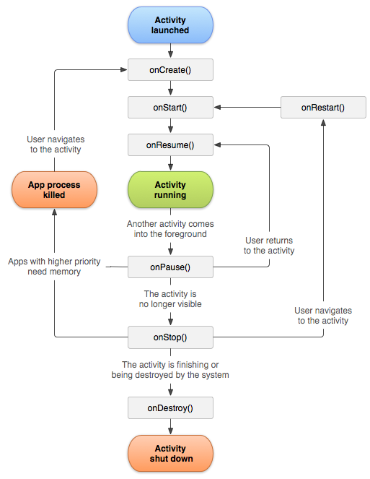
Activity Lifecycle
Notes:
The core functional unit.
Descendents of class Activity.
In general, 1 Activity = 1 Screen. So a typical mobile game, with a splash screen, and play screen, a scores screen and a settings screen probably has four activities.
Each activity is associated with one or more layouts, that are bound via the Activity.setContentView method.
You will recall this figure. Ideally, after you saw it in the first lecture, you went out and did a lot of reading on it, so you now understand all its nuances.
Each event is a good place for certain kinds of code behaviours. Obviously, onCreate is where you do set up code and onDestroy is where you do clean up code, but the other events need to be properly managed as well.
Here is a summary of the events/states and suggested actions for each associated handler.

Slide 4
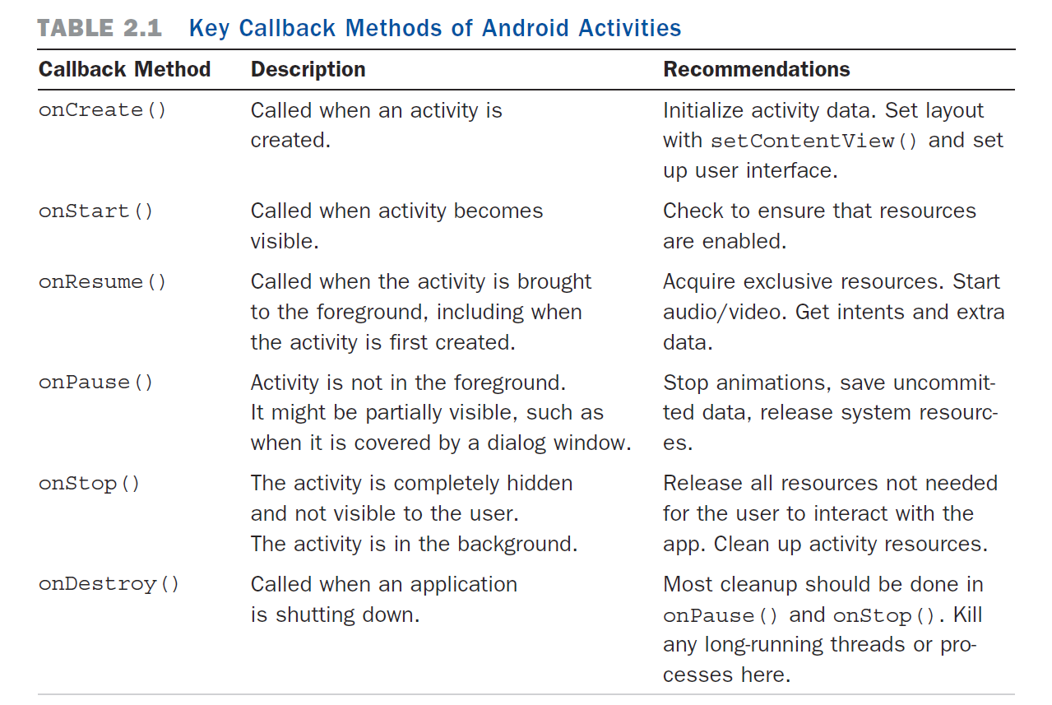
Activity Lifecycle
From Delessio, Darcey & Conder (2014). "Teach Yourself Android Application Development", 3rd Edition
Notes:
Walkthrough
Some of these actions we haven’t learned yet, but you should be able to see the principles – prepare what you need when coming to the foreground, let go of what you can when moving to the background.
Always remember that resources – especially RAM – are very limited in phones, relative to computers. The Android operating system copes with this by ruthlessly destroying threads when memory gets tight.
So you can’t count on your application to sit patiently in the background as you can for desktop development. Make sure that if your process gets destroyed, it will come back in a good state on a restart.
We will see in a minute how to programmatically move between activities (this is where the Intents come in).
When we do that, the system raises these events automatically.
Note also, that our apps can be backgrounded due to the behaviour of other processes (like the one that takes over if a phone call comes in).
Our job is to write the necessary code for each lifecycle event, as we have been doing so far for onCreate.
We will start by considering how to move between activities within your app, and deal with the impact of other concurrently running applications later in the term.
By the way, this is a good book, especially the first half.
I actually like the 2nd edition a little better from an explaining standpoint, but it’s a couple of versions of Android out of date now, so you have to be able to do the updating in your head.
You can get this them as ebooks for about $20.

Slide 5
Intents
android.content.intent
http://developer.android.com/reference/android/content/Intent.html
To transfer control between Activities, or to request a service, you construct an appropriate Intent instance, and pass it to an appropriate system method.
Two kinds of Intent:
Explicit
Implicit
Notes:
To transfer control between activities, we use Intents.
The Android class Intent is used to control computation within a single application and communication between different concurrently running applications.
Each intent is an instance of the class android.content.intent
An individual Intent instance is a little data structure that holds all the information necessary to allow the operating system to provide a service (e.g. accessing a file or a system application or hardware feature) and/or manage flow of control between the activities of a single application.
To transfer control or request a service, you construct an appropriate Intent instance, and pass it to an appropriate system method.
See the docs for full technical details

Slide 6
Intents
Explicit:
The target entity is named specifically.
Implicit:
The target entity is not named.
Rather, some kind of action is requested
The operating system figures out which application activities and/or services can accept the call.
Notes:
Explicit:
The target entity is named specifically. Effectively you say "transfer control to activity Bob"
Implicit:
The target entity is not named.
Rather some kind of action is requested (e.g. "take a photograph“ or “view a web page”)
the operating system figures out which application activity (or activities) can service the call.
This latter facility is one of the distinguishing features of the Android platform and is actually very clever.
Service and content provider programs “register” the kinds of services they can provide (via intent filters).
Vogella: “If an implicit intent is sent to the Android system, it searches for all components which are registered for the specific action and the fitting data type. If only one component is found, Android starts this component directly. If several components are identified by the Android system, the user will get a selection dialog and can decide which component should be used for the intent. “
Note how much flexibility and extensibility this adds to the computational environment.
Note also how it reduces code duplication, and the developer doesn’t have to write code for things that are provided by other entities.

Slide 7
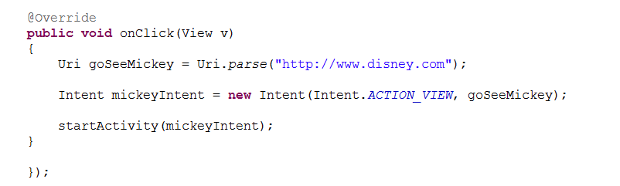
Intent Constructors
Explicit
Intent(currentActivityInstance, targetActivityClass)
Implicit
Intent(action, data)
Notes:
We will be using the explicit form today to move between multiple activities (screens) in a single app.
We will look at the syntax of that in detail in just a minute.
In the implicit constructor action is one of a set of constants defined in the Intent class, and data depends on what action you are calling.
You create the appropriate intent instance, and pass it to (in most cases) the startActivity method.
For example, this button click handler, will, when the button is clicked, open the phone's browser and go to the indicated web site.

Slide 8
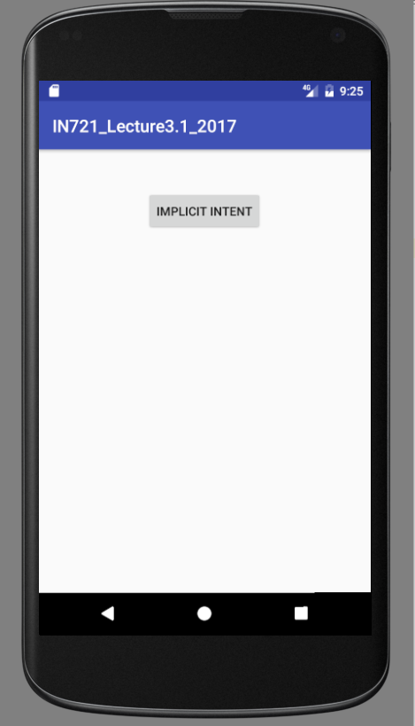
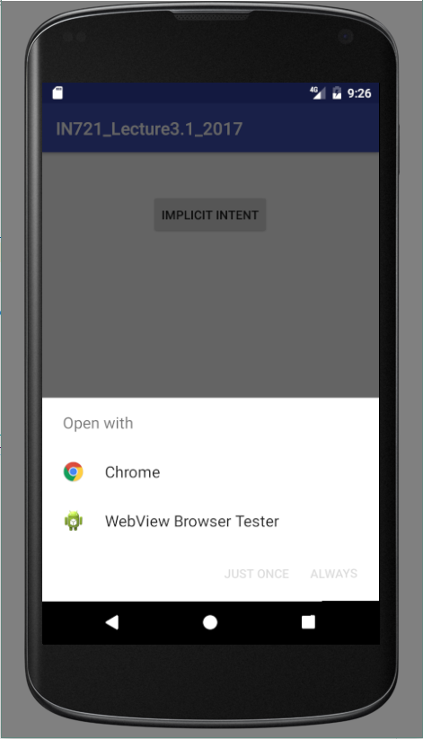

Implicit Intent
Notes:
When you click the button, the system looks for all running apps or services that can support ACTION_VIEW. In this case, there are two, the Chrome browser, and the dev plugin.
When there are multiple registered options, the user is prompted to choose one.
When you choose one, you are taken to the Uri supplied in the intent.
There are a LARGE number of actions, each with particular data requirements. We won't cover them all in detail, but you will have relevant readings.
However, we will look first at explicit intents, which allow us to move between Activities within a single application -- arguably the most important use of the facility.

Slide 9
Activity Navigation
Use explicit Intents to navigate between multiple Activities within a single application.

Slide 10
Activity Navigation
Development process:
Write the Java code and XML layouts for all your Activities (one per screen).
At the point in the code of Activity X where you wish to programmatically pass control to Activity Y:
Create the necessary intent with:
new Intent(currentActivityInstance, targetActivityClass)
Call the Activity method startActivity, passing the intent.
Notes:
Write the code and layouts for all your activities.
At the point in the code of Activity X where you wish to programmatically pass control to Activity Y:
Create the necessary intent with new Intent(currentActivityInstance, targetActivityClass)
Call the system method startActivity, passing that intent.

Slide 11
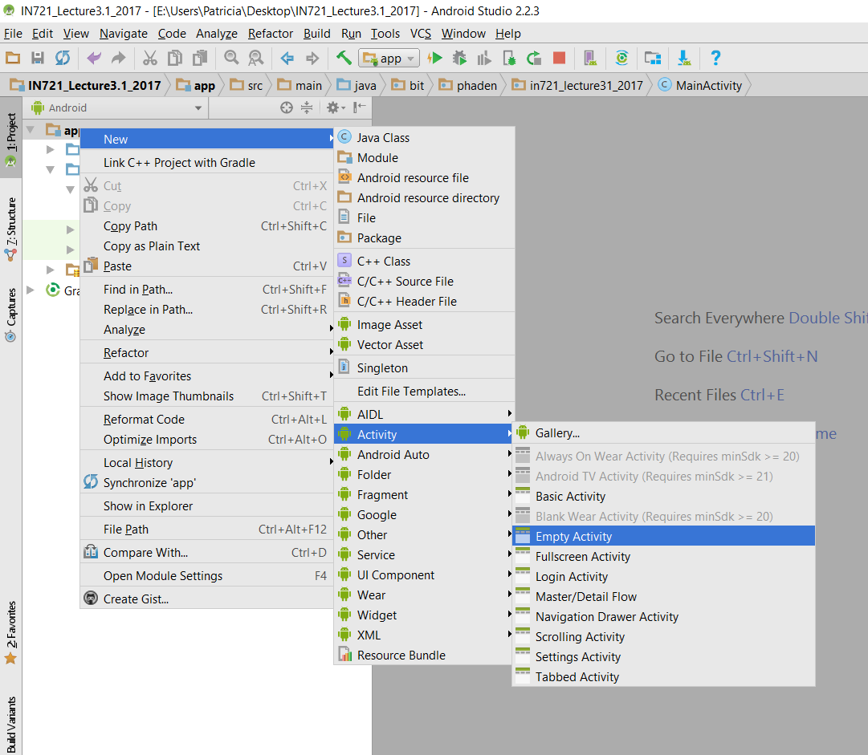
Creating New Activities
Notes:
A safe way to add a new Activity…right click on app in the Package Explorer, then New->Activity->…
There are other ways to do this as well.
You can also just create a new class descended from android.app.Activity in the normal Java way.
But if you do, be careful about this…

Slide 12
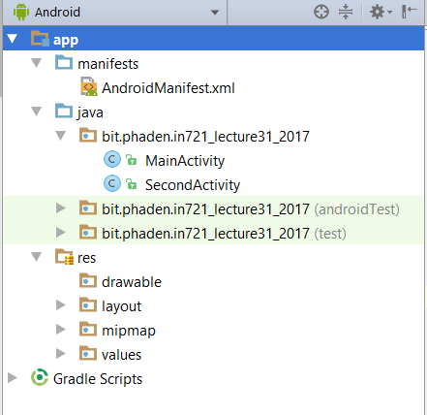
Registering Activities
For Activities within a single app
Each Activity must be added to AndroidManifest.xml
Notes:
This discussion applies only to local registration with your application, not the system-wide registration we mentioned earlier for Services and Content Providers
All activities must be “registered”
This simply means that they must be entered as XML <activity> elements in the appropriate configuration file (AndroidManifest.xml we will look at that file in a minute).
If you use the right-click app blah blah, this is done for you automatically (it’s a good idea to check).
If you create your own class, you must do it by hand.
Let’s look at the manifest now.
We are talking about this file here…

Slide 13
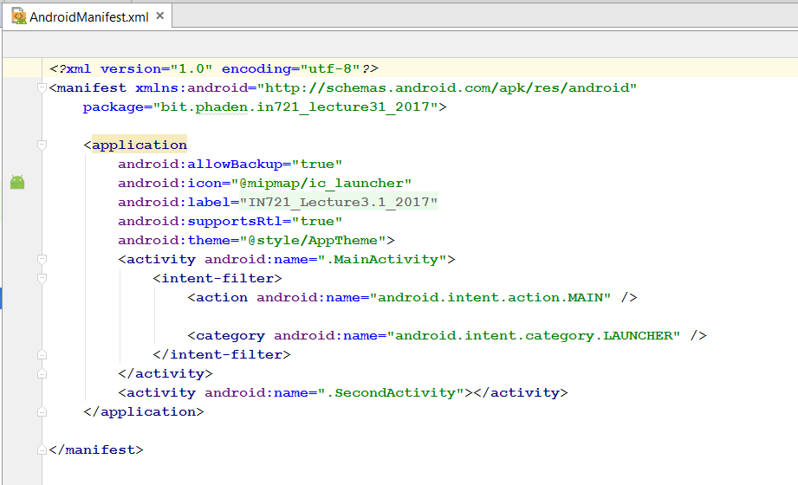
AndroidManifest.xml
Notes:
Here is what the file looks like inside
And here is an example of the XML format for the initial <activity> element you got when you created the project
This code is added automatically when you create your Android application project with the wizard and request a starting empty activity.
This one is actually more complicated than that of the other activities within a single application.
This one, because it is the main default activity for the app, has to be registered with the system using an intent filter. We will look more closely at this in week 5.
Below it, you see the registration of a second Activity.
To register an Activity manually, add an <activity> element and provide values for its android:name and optionally android:label and android:theme in the opening tag.
The name attribute is the class name
The label is a string that will appear in the action bar of the app window.
These both take string values, which can be literal strings or resources constants defined in res/value/strings.xml
Let’s just look more closely at that name...

Slide 14
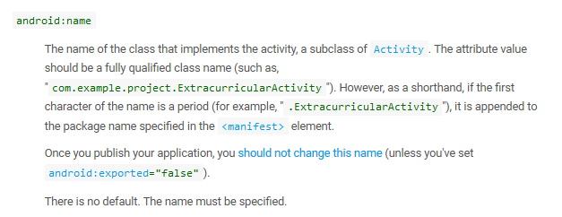
Activity Element
http://developer.android.com/guide/topics/manifest/activity-element.html
Notes:
There is a small syntactic issue here.
Let’s look at that name attribute more closely
Note the “.”
This is just an abbreviation for “the main app package”
If you really wanted to, you could type out the fully qualified name, but this abbreviation is provided to keep things tidy.
How would you know this? ➔ The documentation

Slide 15
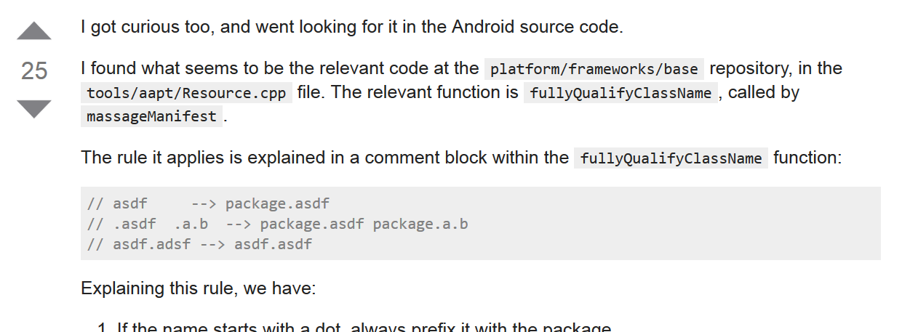
Digression
In a StackOverflow thread about conventions for android:name attribute of <activity>...
Notes:
she goes on to explain it as on the previous slide.
The point is the she “got curious” so she “went looking for it in the Android source code”
This is great.
Not when you’re first learning, because it will depress you, but once you get a grip on the syntax and semantics of a platform, just get in there and dig around.
It’s very educational, and it’s great practice for your first junior dev job, where you will likely be given 47kgs of legacy code and told to fix something...

Slide 16
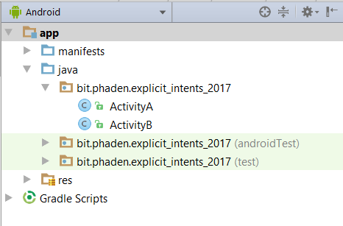
Example
Notes:
Anyway, assume we’ve got our two activities, one way or another…
Example: Assume we have built an android application with two Activity classes called ActivityA and ActivityB.
We now have an app with two screens.
We see them in the Package Explorer, and here are their class declaration headers (in their separate .java files).
Further, assume that we have correctly registered both activities in the project (the Wizard did it, or we did it by hand).
ActivityA was created with the new project wizard, so it is configured in AndroidManifest as the launching (main) Activity.
Assume that at some point we want to switch to ActivityB
Here’s how we switch from ActivityA to ActivityB

Slide 17
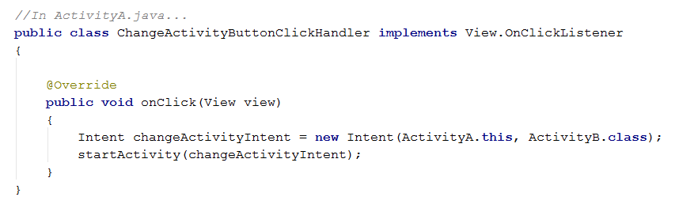
Example
Handler as inner class of ActivityA
...transfers control to ActivityB
What lifecycle events happen?
Notes:
Remember why we have to say ActivityA.this? => because inside an inner class, “this” would refer to the inner class, not the outer class.
Walk through the diagram.
A will get onPause when it loses focus and onStop when it loses the screen (note that this is an oversimplification; the relationship between onPause and onStop and the things that cause each of the to occur is complex. See the docs.)
B will get onCreate the first time, followed by onStart and onResume.
If it was previously created and backgrounded, it will get onRestart, onStart and onResume, or just onResume if it was only paused, not stopped.
Keep this in mind if you have counters, preloaded resources, etc.

Slide 18
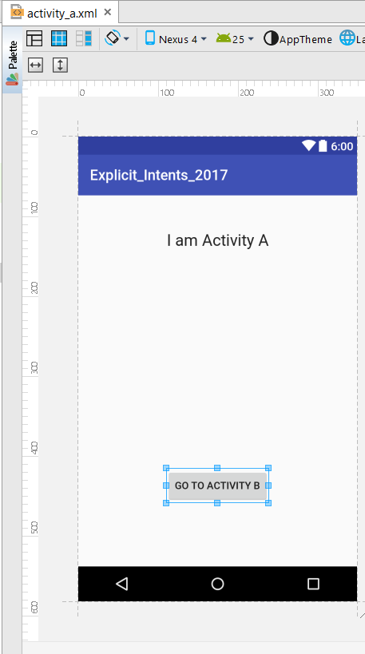
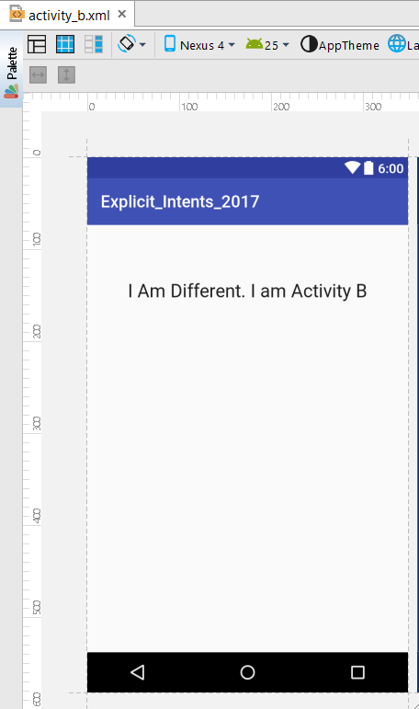
Example
Notes:
Assume these layouts...and we wire up that handler to the button.

Slide 19
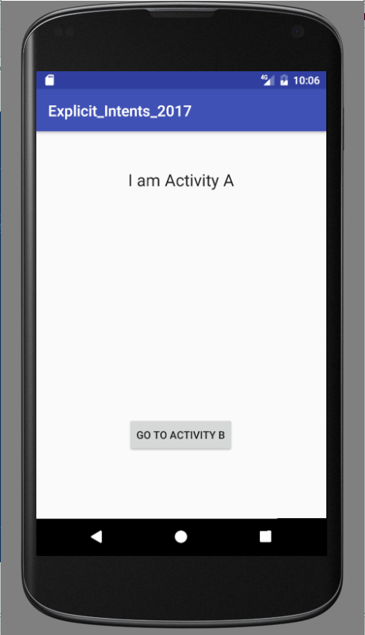
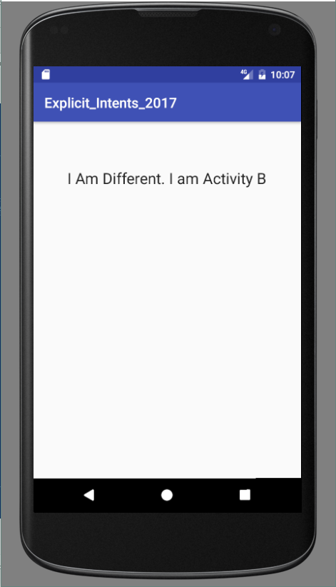
Example
Notes:
The app opens like this....
And on button click changes to Activity B.
As discussed, all the Activity B life cycle events are raised, and any code you have bound to those events will be executed.

Slide 20
Practical
Basic Activities and Intents

